Slide 1
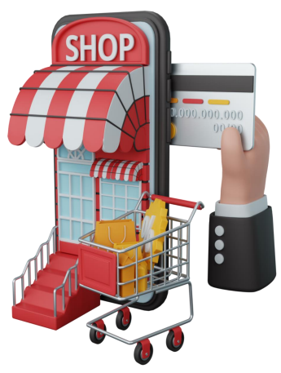
Sterling E Commerce Performance Analysis

Slide 2
Introduction
Sterling E-Commerce is a one-stop online shopping destination for a wide range of high-quality products whose mission is to provide their customers with the best shopping experience possible and focus on quality, affordability, and convenience of their clients.
From the data gather ( Oct 2021 – Sept 2022), we provided valuable Insights into customer’s Interactions with company’s products across the country using a meticulous data evaluation process, which involve data cleaning and visualization.

Slide 3
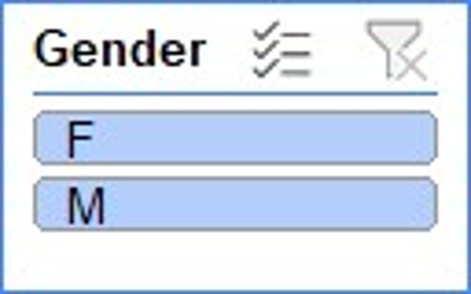
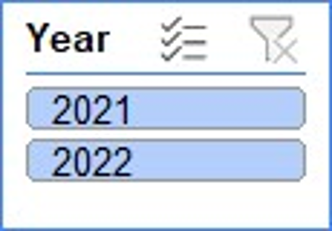
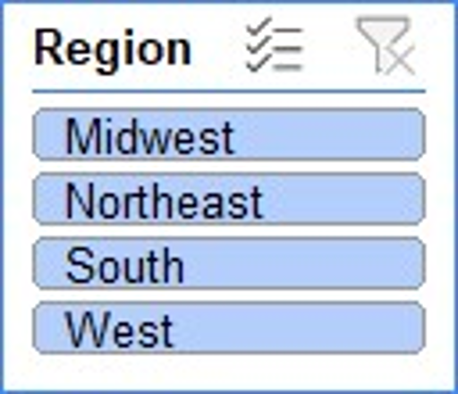
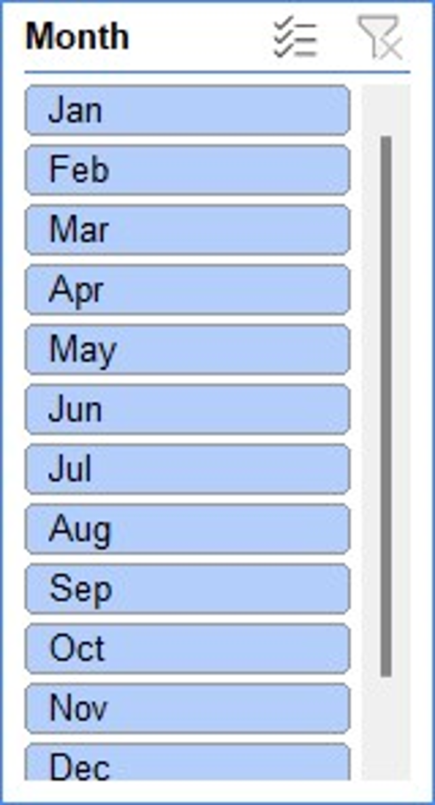
STERLING E-COMMERCE

Slide 4
Total Male
Total Female
STERLING E-COMMERCE

Slide 5
Revenue Trend For The Period In View
Total Number of Qty ordered 851,577.
Total Revenue $ 2,310,611,039.
Dec 2021 stood out to have the highest Revenue & Qty of Order.
Notably, Feb 2022 recorded the Lowest Revenue.
If The current business trend of E-commerce persists , the average sales projection for the next 3 months in 2022 ranges between $ 17,826,937 and $17,892,050,36.
However , it is important to recognize that projection might undergo adjustments due to factors beyond our control.
Of all the forecast approach been used the Simple linear Regression has the highest accuracy of 99.70%.

Slide 6
Yearly Performance
In 2021, the revenue amounted to $ 73,583,702 and the Qty ordered was 249,620.
In 2022, a revenue of $157,477,335 has been recorded and the Qty ordered is 601,957.
The quarterly performance could not be explored because we have just 3months record from 2021, hence can’t compare with 2022.

Slide 7
Category Performance
Mobile and Tablets is the most bought products among all the 15 categories of product , with 718,356 qty order and revenue of $128,600,063.
Appliances follows closely with 769,889 qty ordered and $ 29,805,770 generated.
Books recorded the lowest revenue of $ 32,247 but qty ordered was 849,446.

Slide 8
Customer’s Behavior
Based on our analysis , we identified 63,646 unique customers. Among these are 51% male and 49% female.
In accessing the impact of each customers by revenue generated from their order, the highest revenue was made from Dobbins Everette followed by Cobb Joleen but in terms of qty ordered Gonzalex Joel placed the highest orders.

Slide 9
Region
We observed that across the country , South generated the highest revenue , follow by Midwest . And in terms of categories, Mobiles and Tablets were most purchased.
The revenue generated by customers in South and Midwest are 38.80% and 27.23% respectively, hence, amounting to 66.03% . indicating their substantial contribution to our financial performance compared to other regions.

Slide 10
Mode of Payment
The cod payment method stands out as the most favored option, representing the highest transaction method with 101,750 instances , followed by easypay with 68,915 instances.

Slide 11
Recommendation
The company should leverage the success from December, the highest sales month in 2021, by analyzing the key factors behind this performance. Allocate resources and marketing strategies to replicate these factors throughout the year.
Increase focus on selling products in the South and Midwest regions, where demand has been stronger.
Implement more sales incentives nationwide to boost overall sales performance.
Reduce stock levels for underperforming products to free up capital for higher-demand items, ensuring healthier cash flow.
Prioritize stocking top-performing categories, as they have consistently driven sales and possibly revenue.
Introduce loyalty programs or exclusive incentives to reward top customers to encourage repeat purchases.
Study the reasons behind the low patronage outside the South and Midwest regions to improve performance in other areas.

